Slide 1
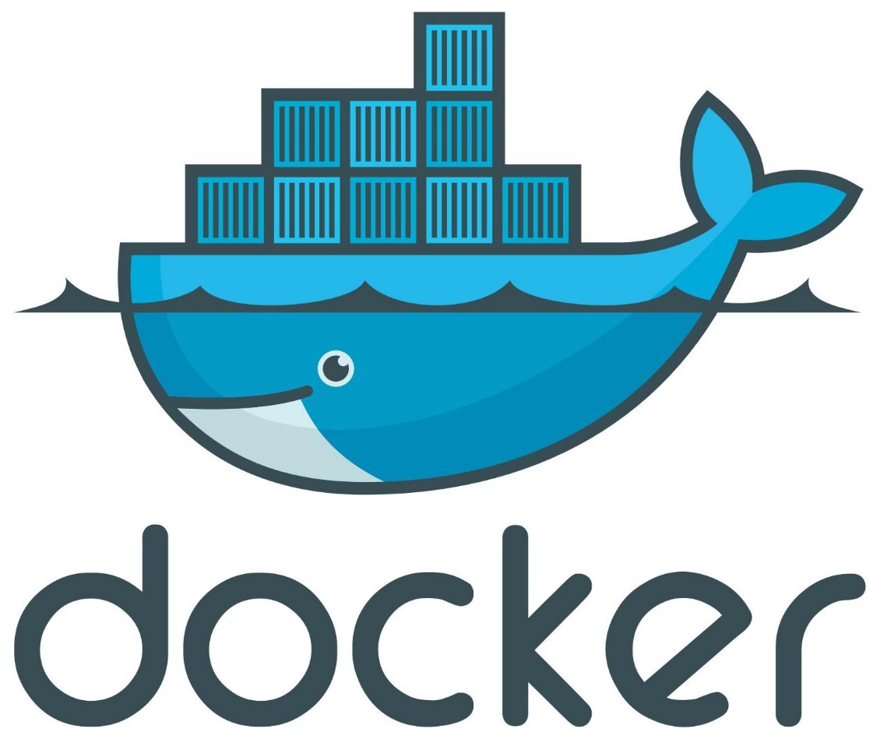
Dr. Emmanuel S. Pilli

Slide 2
Contents
What we were using ?
What problem we were facing ?
What could be the solution ?
What is Docker (A to Z) ?

Slide 3
Contents
What we were using ?
What problem we were facing ?
What could be the solution ?
What is Docker (A to Z) ?

Slide 4
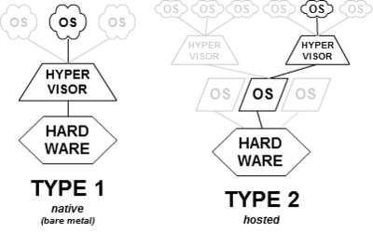
Hypervisor
A hypervisor or virtual machine monitor (VMM) is computer software, firmware or hardware that creates and runs virtual machines.

Slide 5
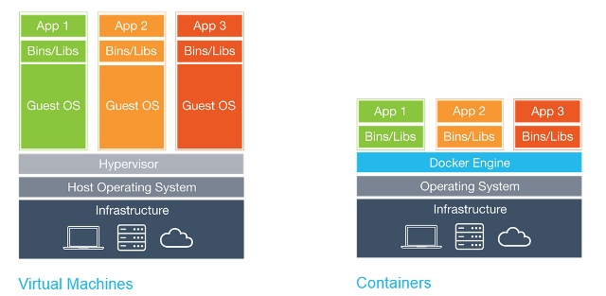
VMs vs Containers

Slide 6
VMs vs Containers
As above shown in diagram we are running 3 applications. In first diagram we using 4 Operating systems to run 3 applications. It will increase size burden as well processing time to run these application .
In second diagram we can see that to run 3 applications we are just using one operating system. So benefit of containerization can be seen.

Slide 7
Contents
What we were using ?
What problem we were facing ?
What could be the solution ?
What is Docker (A to Z) ?

Slide 8
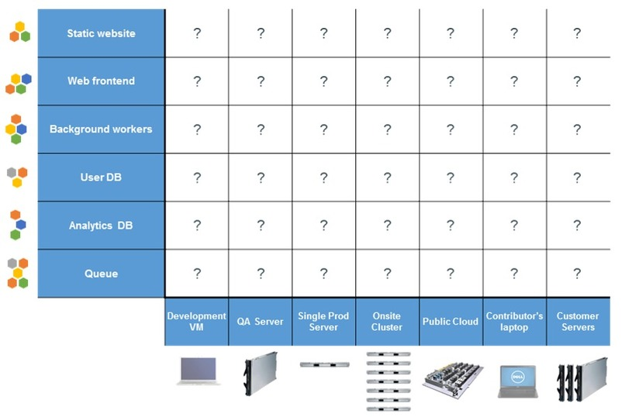
Multiple Stacks and Hardware Environments
There is a huge number of combinations and permutations of apps/services and H/W environments that need to be considered every time an application is written. This creates a difficult situation for developers and the folks in operations who are trying to re-create same environment.

Slide 9
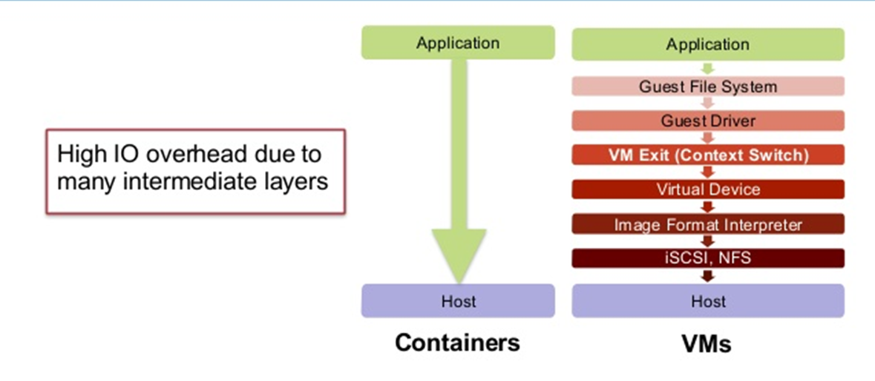
Overhead of intermediate layers

Slide 10
Contents
What we were using ?
What problem we were facing ?
What could be the solution ?
What is Docker (A to Z) ?

Slide 11
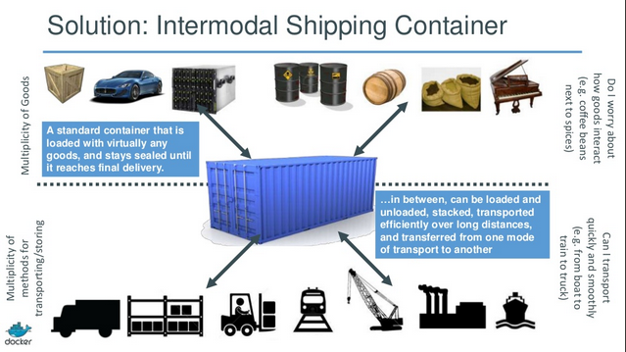

Slide 12
Containers
Containers allow a developer to package up an application with all of the parts it needs, such as libraries and other dependencies, and ship it all out as one package.
Commonly known as “operating system-level virtualization” or “OS Virtual Environments” .
Containers differ from hypervisor level virtualization.
The main difference is that the container model eliminates the hypervisor layer, redundant OS kernels, binaries, and libraries needed to typically run workloads in a VM.

Slide 13
Contents
What we were using ?
What problem we were facing ?
What could be the solution ?
What is Docker (A to Z) ?

Slide 14
Why Docker ???
Docker is hotter than hot because it makes it possible to get far more apps running and it also makes it very easy to package and ship programs.
Developers have a solution to build once and deploy anywhere.
Ops/Admin has a solution to configure anywhere.
Docker enables Consistent Environments

Slide 15
Docker
Docker is a containerization platform (Container Orchestration).
Docker packages your application and all its dependencies together in the form of a “Docker container” to ensure that your application works seamlessly in any environment.
Docker enables any application and its dependencies to be packaged up as a lightweight, portable, self-sufficient container.

Slide 16
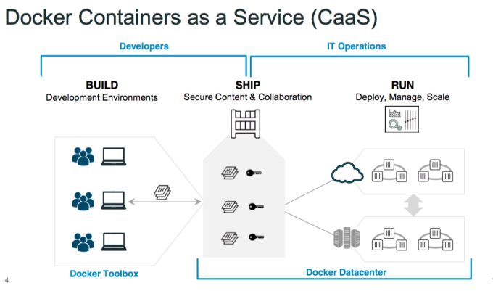

Slide 17
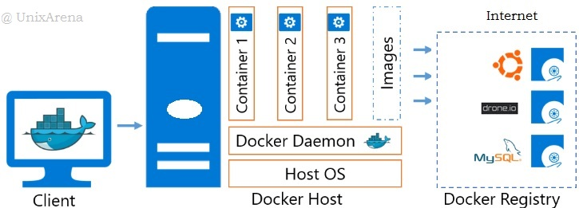
Docker Architecture

Slide 18
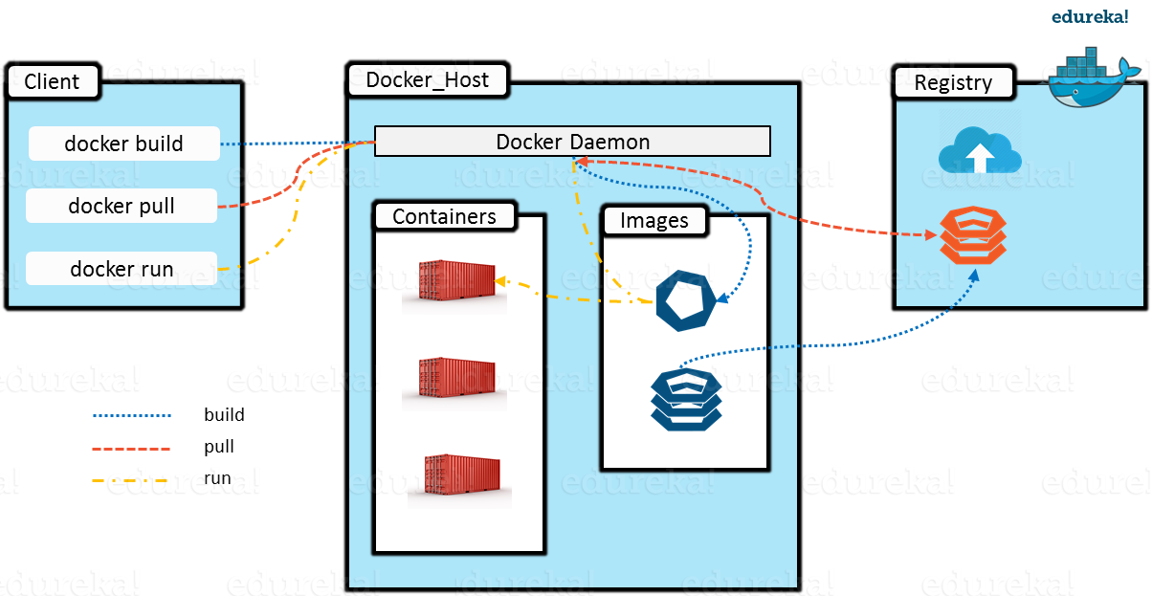
Docker Components

Slide 19
The Docker client
When you use commands such as Docker run, the client sends these commands to Dockered, which carries them out.
The Docker command uses the Docker API. The Docker client can communicate with more than one daemon.
The Docker Daemon
For Docker API requests and manages Docker objects such as images, containers, networks, and volumes.
A daemon can also communicate with other daemons to manage Docker services.

Slide 20
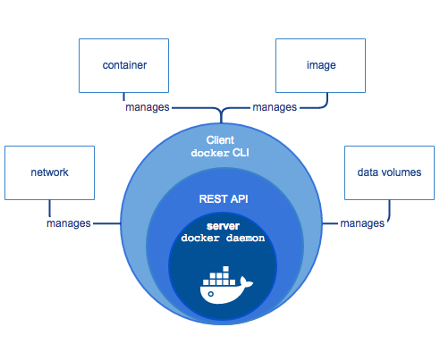
Docker Daemon

Slide 21
Docker Daemon (Engine)
Docker Engine which is the heart of the Docker system.
Docker Engine is simply the Docker application that is installed on your host machine. It works like a client-server application which uses:
A server which is a type of long-running program called a daemon process
A command line interface (CLI) client
REST API is used for communication between the CLI client and Docker Daemon
We build our Docker images and run Docker containers by passing commands from the CLI client to the Docker Daemon.

Slide 22
Docker Image
A Docker Image is the template (application plus required binaries and libraries) needed to build a running Docker Container (the running instance of that image).
An instance of an image is called a container. You have an image, which is a set of layers as you describe. If you start this image, you have a running container of this image.
An image is an inert, immutable, file that's essentially a snapshot of a container. Images are created with the build command, and they'll produce a container when started with run . You can have many running containers of the same image.

Slide 23
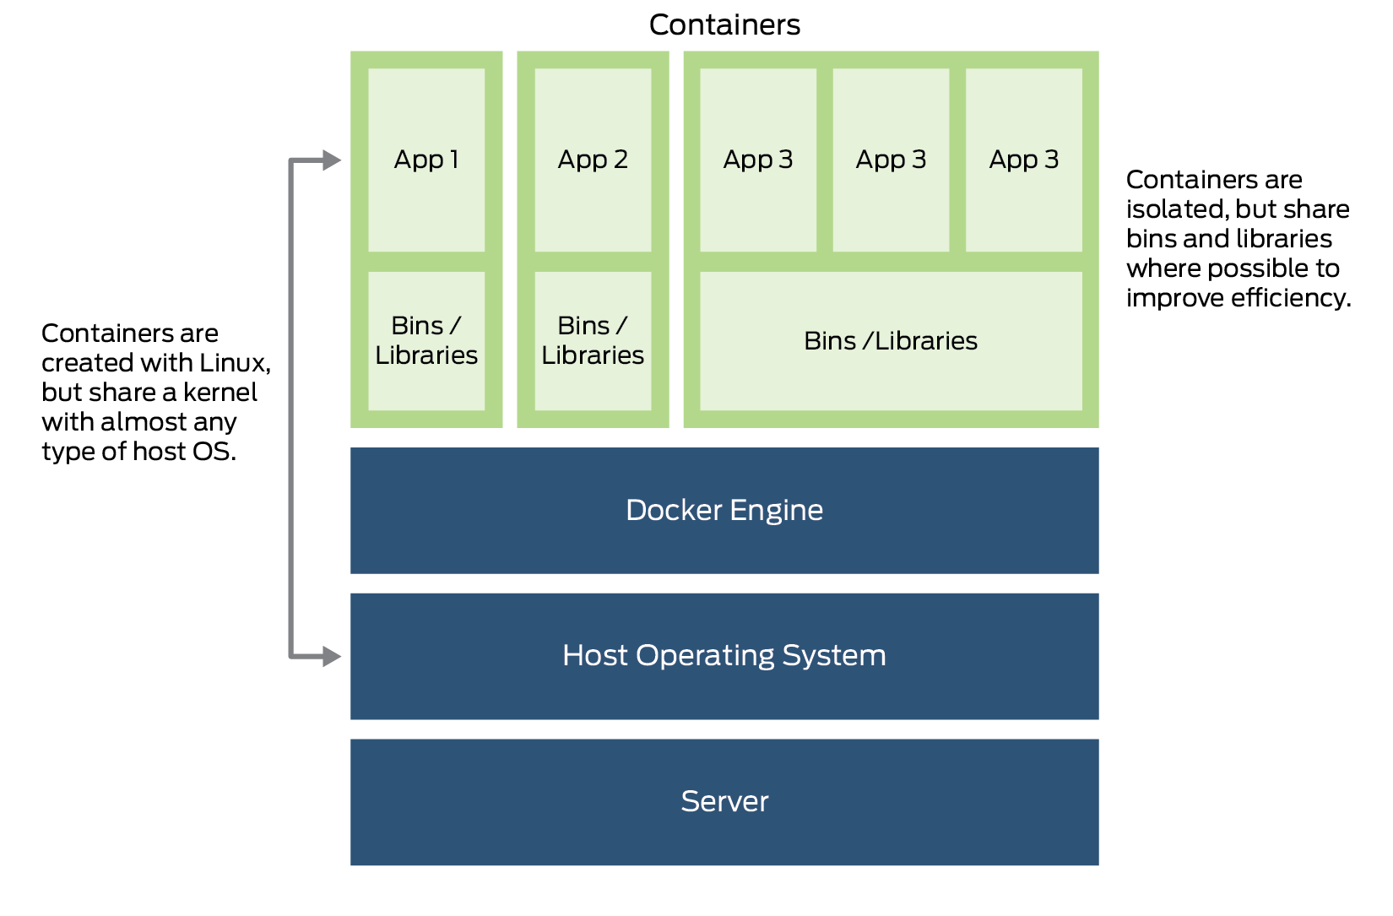
Docker Container
Containers are the ready applications created from Docker Images or you can say a Docker Container is a running instance of a Docker Image and they hold the entire package needed to run the application.

Slide 24
Docker Registry
Docker Registry is where the Docker Images are stored. The Registry can be either a user’s local repository or a public repository like a Docker Hub.
Docker Hub is Docker’s very own cloud repository similar to GitHub.
The Registry is a stateless, highly scalable server side application that stores and lets you distribute Docker images.

Slide 25
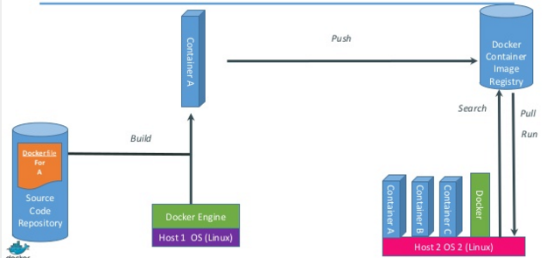
How it works

Slide 26
Techniques behind Docker
Control Groups
Kernel Name Spaces
Union File system
Capabilities
Copy on Write

Slide 27
Docker Benefits
Scalable
Containers are light weight so scaling up and scaling down is very easy . Launch more container as we need them or we can shut down as we don’t need them .
Density
Portable
We can move them very easily .
Deployment
Container can run or can be deployed anywhere (laptops , desktops , physical servers etc. )

Slide 28
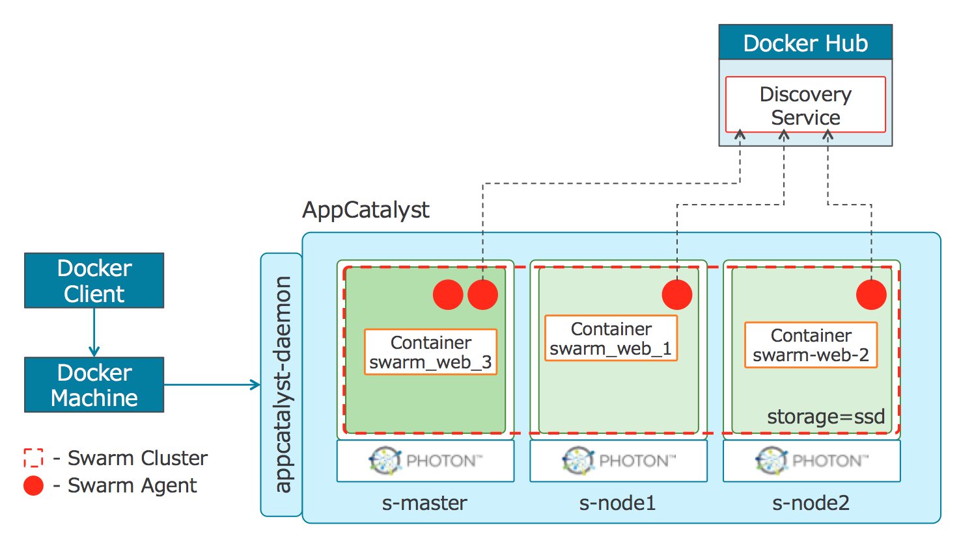
Docker Swarm

Slide 29
Docker Swarm
Docker Swarm is a clustering and scheduling tool for Docker containers. With Swarm, IT administrators and developers can establish and manage a cluster of Docker nodes as a single virtual system.
Clustering is an important feature for container technology, because it creates a cooperative group of systems that can provide redundancy, enabling Docker Swarm failover if one or more nodes experience an outage.
A Docker Swarm cluster also provides administrators and developers with the ability to add or subtract container iterations as computing demands change.

Slide 30
Kubernetes
Kubernetes is an open source container management system.
Kubernetes was released in February 2015.
Google designed Kubernetes to orchestrate Docker containers.
Auto scale applications, Horizontal Infrastructure Scaling (new servers can be added or removed easily) as and when needed.

Slide 31
Kubernetes Composition
The base unit of deployment in Kubernetes is called a Pod, which consists of one or more containers.
All of the containers in a pod are scheduled onto the same host and can communicate with each other over the localhost loopback interface.
Kubernetes resources are typically defined in configuration files, which can be written in the YAML or JSON formats.
The kubectl command line tool is then used to send these configurations to the Kubernetes cluster.

Slide 32
Apache Mesos
Apache Mesos is designed for data center management, and installing complex applications such as Kubernetes on top of data center resources.
It provides resources to applications that run on top of it. Apache Mesos is best suited for data centers where multiple complicated applications will need to be setup and configured.
Mesos is designed to run other applications on top of it, including Kubernetes. It is possible to run containers directly on Mesos, but choosing a more container-centric application to run on top of Mesos such as Kubernetes will provide better workflows for deploying containerized applications.

Slide 33
Apache Mesos
The Mesos kernel runs on every machine and provides applications (e.g., Hadoop, Spark, Kafka, Elasticsearch) with API’s for resource management and scheduling across entire datacenter and cloud environments.
Apache Mesos abstracts CPU, memory, storage, and other compute resources away from machines (physical or virtual), enabling fault-tolerant and elastic distributed systems to easily be built and run effectively.

Slide 34
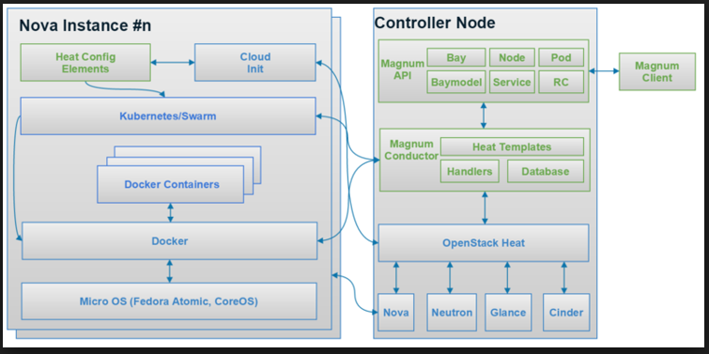
Magnum
Magnum is an OpenStack API service developed by the OpenStack Containers Team making container orchestration engines such as Docker Swarm, Kubernetes, and Apache Mesos available as first class resources in OpenStack.

Slide 35
Docker is not just …
Configuration management tool (Puppet, Chef, and JUJU)
Hardware Virtualization Solution (VMware, KVM, XEN)
Cloud Platform (Open Stack, and Cloud Stack)
Deployment Framework (Capistrano, Fabric, etc.)
Workload Management Tool (Mesos, Fleet, etc.)
Development Environment (Vagrant, etc.)

Slide 36
Virtualization vs Containerization
Hypervisor | Containers
Runs operating systems | Runs processes
Heavyweight isolated virtual machines | Lightweight kernel namespaces
Can theoretically emulated any architecture | Is less flexible in architecture emulation
VMs start via full boot-up process | Very fat namespaces + process creation
Platform-oriented solution | Service-oriented solution

